Slide 1

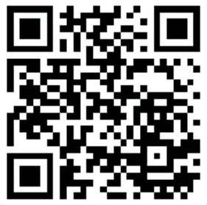
All Software is Open Source
An Introduction to
Reverse Engineering
Dmitriy Beryoza
Slides can be found at https://github.com/0xd13a/presentations

Slide 2


About me
Dmitriy Beryoza
@0xd13a on Discord/Twitter
https://www.linkedin.com/in/beryozad
Senior Security Researcher at Vectra AI
Prior to that - Pentester/Secure Software Development Advocate with X-Force Ethical Hacking Team at IBM Security
25+ years in software design and development
Ph.D. in Computer Science, CEH, OSCP, CISSP, CCSP
Interests: reverse engineering, secure software development, CTFs

Slide 3

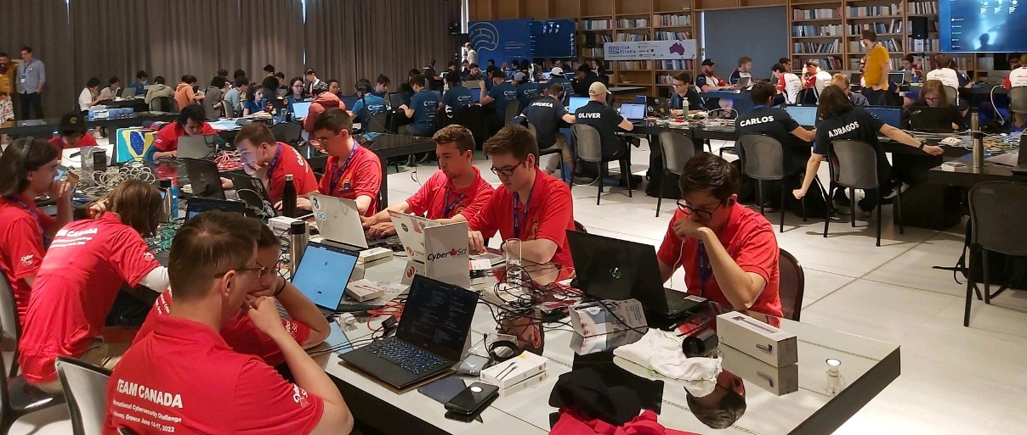

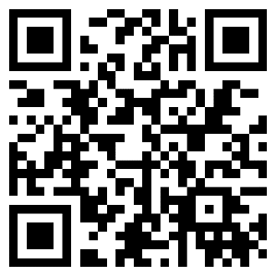
PSA: Canada’s Cyber Security Challenge
National cybersecurity competition for university students (running since 2010)
Regional and national events (40+ teams), winners represent Canada internationally
Team Canada competed in Prague, Athens, and Vienna
Join us! Become a:
Sponsor - help us grow the next generation of cyber professionals
Employer - interview and hire the brightest students in the field
Organizer - join our team to organize events and build challenges
Player - start or join your university team
https://cybersecuritychallenge.ca/

Slide 4

Agenda
What is Reverse Engineering?
Applications of RE
What Can You Reverse and Why?
Legal Issues
Categories of RE
Code Examples
Tools
Common Obstacles
How to Practice
General Strategies
Resources

Slide 5

What is Reverse Engineering
Reverse Engineering (or reversing) - process of understanding how a device, system, piece of software works by examining it (without having access to original design specs, source code, etc.)
Becomes necessary when the original design information is not available or intentionally withheld
Humans have been doing RE forever
Many inventions in human history have been analyzed and copied
All natural sciences are essentially RE
Nature doesn't come with a manual
You have probably done RE in your life more than once
The toy you pulled apart as a kid to see what's inside
The clock you tried to fix (unsuccessfully)

Slide 6

Modern Uses for RE
Security/vulnerability research
Pentesting
Malware analysis
Military/intelligence work
Scientific research
Commercial research/product compatibility
Independent quality control
Patent infringement detection
...and more
We will talk about software RE
But that includes most hardware too - much of modern hardware is driven by software

Slide 7

Why Should You Do RE?
A lot of software and hardware around us are "black boxes"
Documentation and architecture blueprints are scarce or withheld
We want to be able to:
Analyze product for safety/quality
Analyze product for security/hidden backdoors
Recover legacy knowledge
Build compatible products
Patch in behavior changes or bug fixes
RE gives you that power
"When you know assembly - all software is open source" -- Unknown

Slide 8

Why Should You Do RE? (cont.)
Required skill if you are in Infosec
Vulnerability analysis (most CVEs require some RE)
Pentesting (analyzing customer software for holes)
Incident response (samples of ransomware, malware, phishing, C2, remote shells)
RE can be lots of fun!
Gives you sense of discovery and accomplishment
You are overcoming challenges and discovering secrets
You will probably like it if you like:
Putting together puzzles
Solving crosswords
Geocaching
…

Slide 9
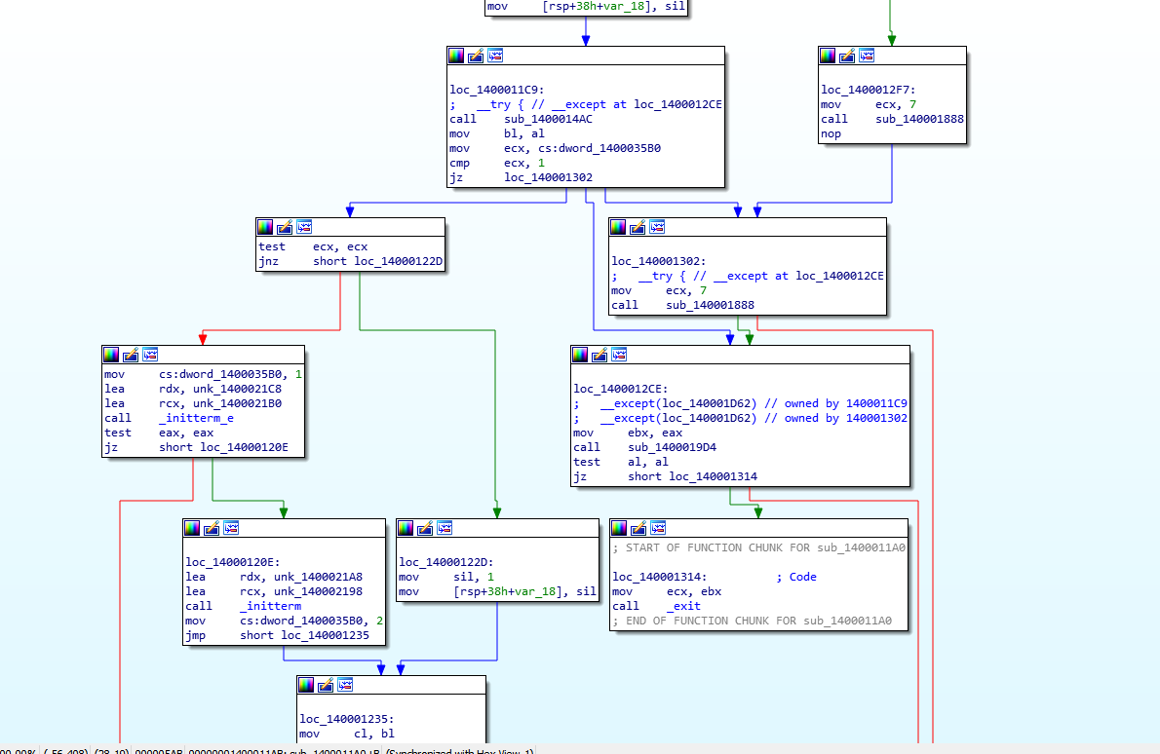
What Can You Reverse?
Pretty much anything!
Windows, macOS, Linux natively compiled executables
Compiled Java, .Net, Python portable code
iOS/Android apps
Minified/obfuscated JavaScript and WASM
Obfuscated PowerShell
Obfuscated Office VBA
Compiled automation scripts (AutoIt, AutoHotKey, etc...)
BIOS/bootloaders
Shellcode
Hardware firmware
…and the list goes on

Slide 10
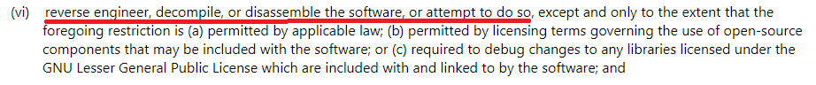
Legality of RE
Big caveat - I'm not a lawyer, and this is not legal advice
Is RE Legal? - It depends...
Most license agreements contain anti-RE clauses
Vendors want to protect their intellectual property
Vendors want flaws to be harder to find
Existing laws restrict RE
Digital Millennium Copyright Act (DMCA)
Computer Fraud and Abuse Act (CFAA)
Copyright law
EU Directive 2009/24
...and others
Apple iOS 14 License Agreement
Windows 10 Retail License

Slide 11
Legality of RE (cont.)
You have more protection if you own the device or software you are reversing
The Fair Use defense in Copyright Law
Using copyrighted works for good-faith security research is likely fair use
Under DMCA legal owner of the program may RE it and circumvent its protection to achieve "interoperability"
Intent and what you do with information discovered through RE is key
For deeper analysis see this guide by Harvard Law School & EFF: https://clinic.cyber.harvard.edu/files/2020/10/Security_Researchers_Guide-2.pdf

Slide 12

Legality of RE: 3 Categories
Safe to do
RE of non-commercial code or anything you yourself produce
RE of commercial products done in private, without publishing or taking advantage of results
Malware analysis
Tread carefully
RE of commercial products for security research (bounty programs offer some protection)
Publishing of limited reversed code/data as part of responsible vulnerability disclosure
Publishing of tools based on RE discoveries
Famous RE legal cases
Jon Lech Johansen arrested in 2000 for circumventing DVD copy protection; acquitted
Dmitry Sklyarov arrested after DEF CON in 2001 for circumventing Adobe protections; charges eventually dropped
Even if what you are doing is not breaking the law, legal harassment is possible
Lawyer-up!
Large-scale disclosure of discovered proprietary information, or (even worse) profiting from it
Building compatible or competing products

Slide 13
Types of RE
Data/communications analysis
Analysis of proprietary data formats (graphics, storage, databases)
Analysis of proprietary network protocols
Requires careful experimentation and use binary editors and capture tools
Disassembly
Conversion of compiled binary to human-readable machine instructions
Native code (x86, ARM, MIPS, ...) and p-code (JVM, .Net, Python, ...)
Decompilation
Attempt to recover original code from compiled binary
For native code results are spotty due to code optimizations; a C-like pseudocode is usually recovered
P-code is higher level and results are much better

Slide 14
Static vs. Dynamic Analysis
Static involves analysis without execution
Helps where neither hardware nor emulators are available
Helps when debugging is not possible or anti-debugging measures are employed
Dynamic is analysis though execution and debugging
Helps in cases of obfuscated/compressed/encrypted code and data
Helps confirm insight gleaned from static analysis
Disassemblers and decompilers are often integrated with debuggers
A combination approach often works best

Slide 15
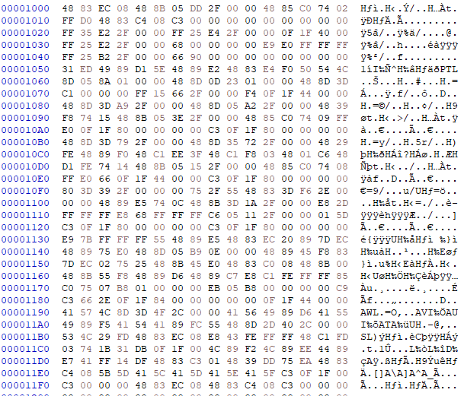
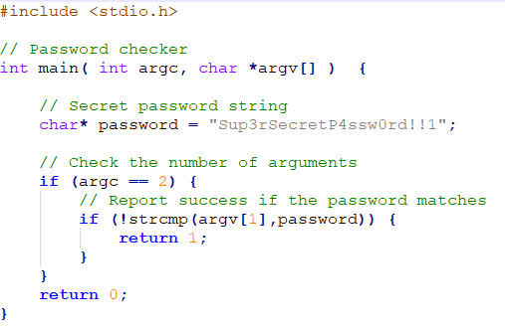
Disassembly Example: C
Consider a simple C example
Compiled representation looks intimidating…

Slide 16
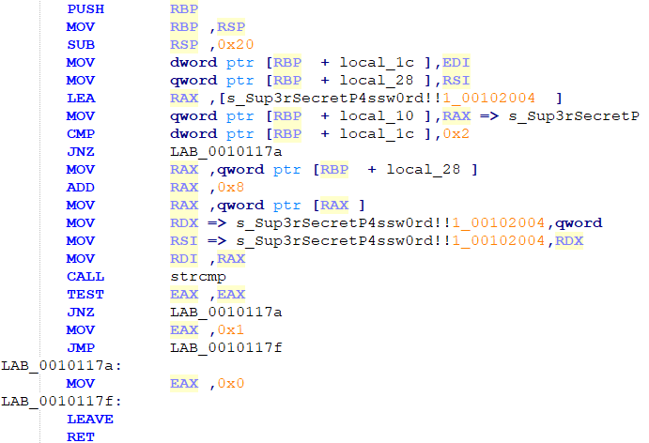
Disassembly Example: C (cont.)
But if we open the executable in a disassembler things look much clearer
Even though you may not know assembly language you can get a rough idea of how C gets translated into it

Slide 17
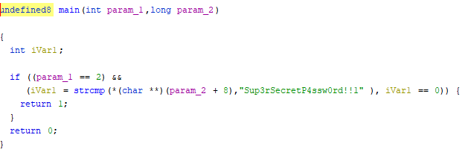
Decompilation Example: C
With a decompiler we can get an even better picture of the code
Quality of decompilation varies and depends on complexity of an application

Slide 18
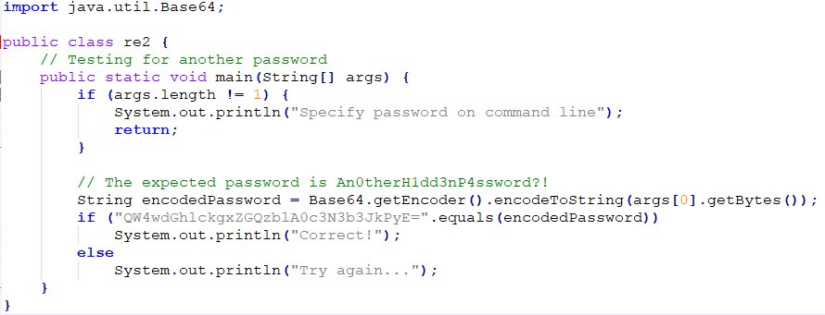
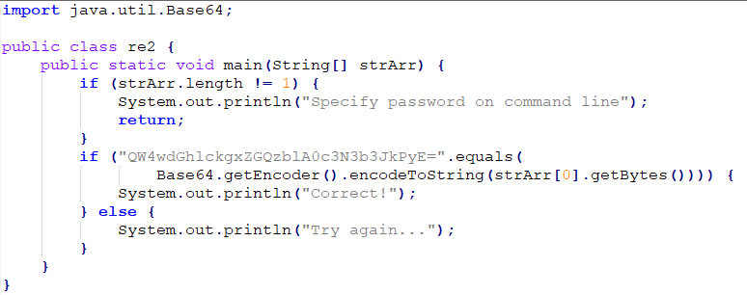
Decompilation Example: Java
Quality of decompilation of p-code language is much better

Slide 19
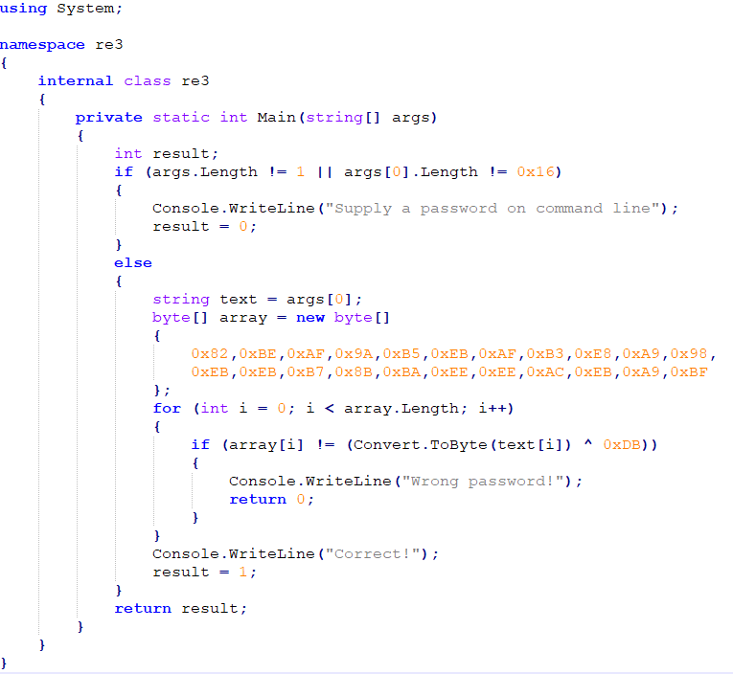
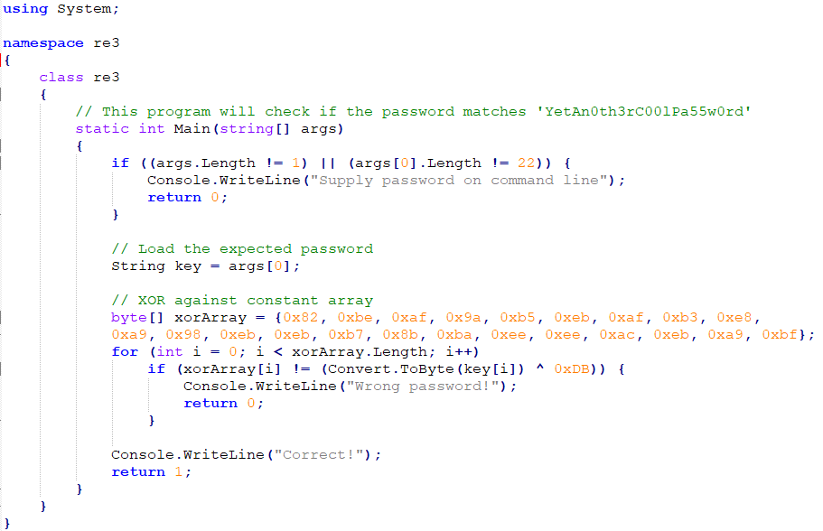
Decompilation Example: C#/.Net

Slide 20
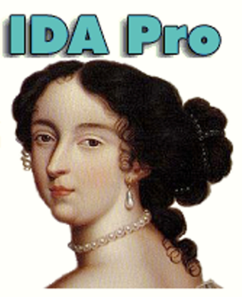
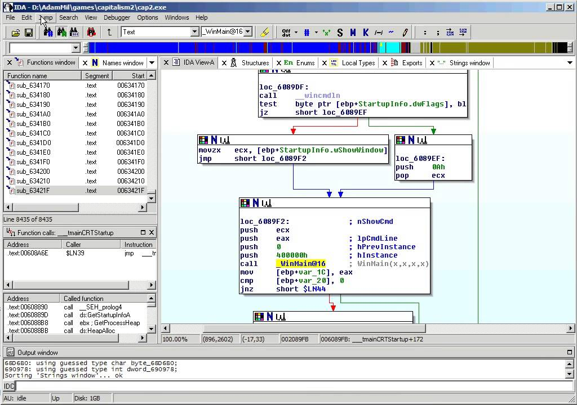
Tools: IDA Pro
The ultimate RE tool
Tons of support for many processors and environments
Disassembler + Debugger
+Decompiler add-on (Hex-Rays)
Plugins, scripting, …
Expensive - US$2K-4K
…but there is a Free and a Home (US$365) version

Slide 21

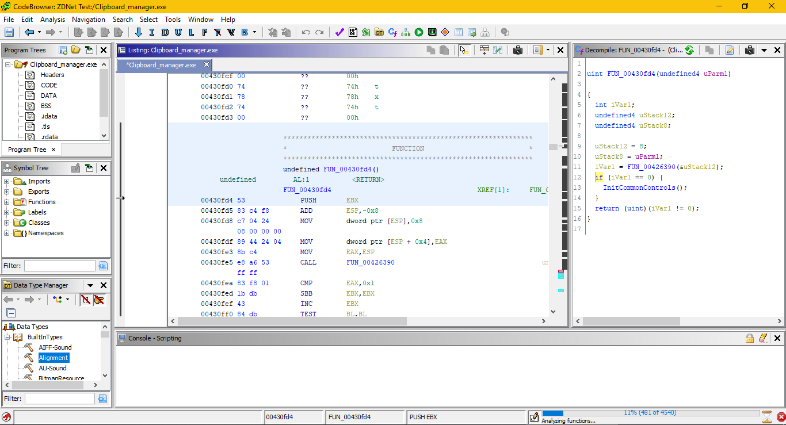
Tools: Ghidra
Open-sourced by NSA (!)
Many supported architectures
Disassembler + Decompiler
Now has a Debugger too
Plugins, scripting, …

Slide 22
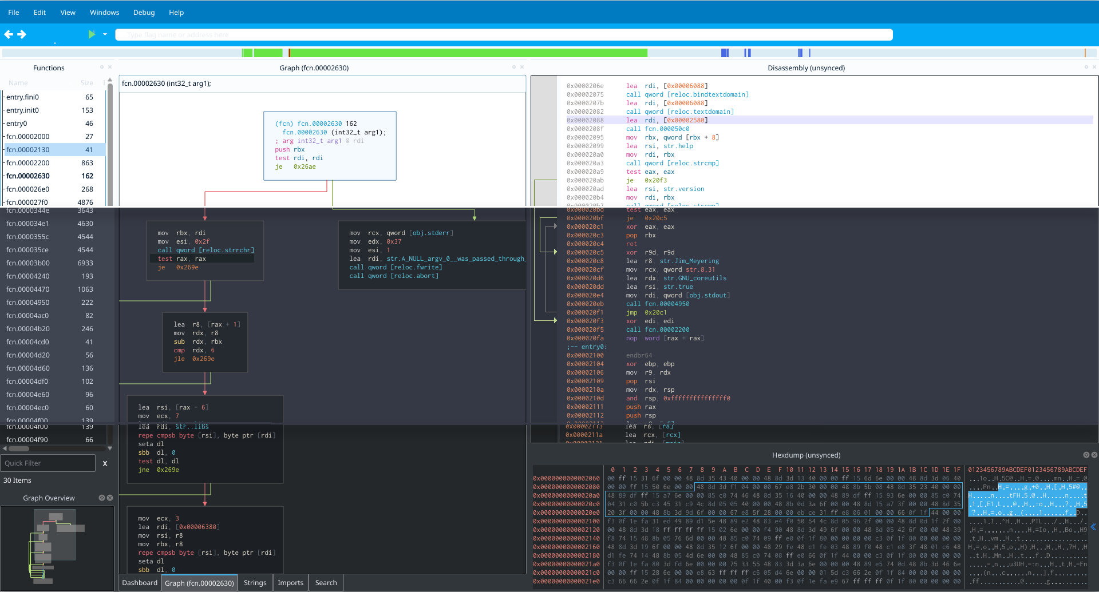
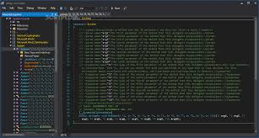
More Tools
Complete frameworks
Radare2 (+ Cutter GUI)
Binary Ninja
Decompilers
retdec
Snowman
Debuggers
OllyDbg
EDB
x64dbg
.Net
dnSpy
ILSpy
Java
JD-GUI
CFR
Python
uncompyle6
WASM
wasmdec
VMs
FlareVM
REMnux
… and the list goes on

Slide 23
Obstacles: Information Lost in Compilation
As part of compilation and optimizations code is made more difficult to reverse
Lost:
Code comments
Meaningful names of functions and variables
Structure of data
Objects (e.g. C++)
Variables move between stack and registers
Execution flow constructs obscured (loops, conditional statements, exception handling, ...)
Function inlining and embedding of libraries explodes body of code

Slide 24
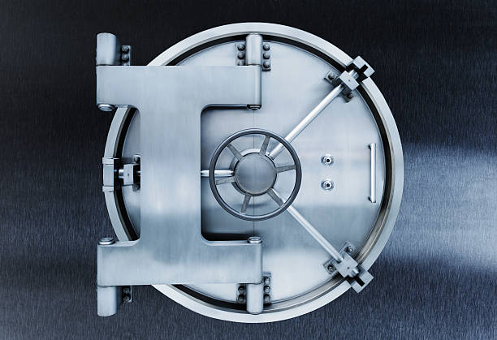
Obstacles: Counter-reversing Measures
Software publishers know about RE and are not happy about it
Many countermeasures are deployed to complicate analysis
Obfuscation
Deliberate name obfuscation for scripting and p-code languages
Code minification
Compression
Code and data compressed with "packers" (e.g. UPX)
Encryption
Code and data decrypted at run time
Multiple nested levels and algorithms can be used

Slide 25
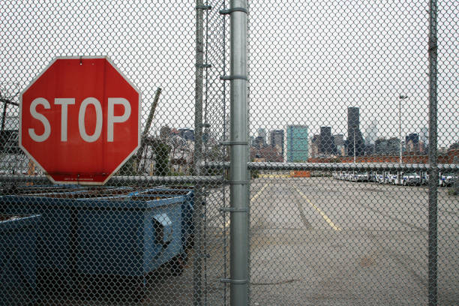
Obstacles: Counter-reversing Measures (cont.)
Anti-disassembly
Jumps into the middle of instruction
False branches
Self-modifying code
Anti-decompilation
Program flow intentionally obscured
Jump to register
Jumps through return
Call as a jump
Useless/dead code insertion
Extreme optimization
VM implementation (e.g. OISCs - Subleq, M/o/Vfuscator)

Slide 26

Obstacles: Counter-reversing Measures (cont.)
Anti-debugging
Debugger detection
VM detection
Sporadic insertion of breakpoints
Use of debug handlers (e.g. PTRACE) for execution
Signal-based execution
SEH-based execution
Alarms and time-dependent code
...and this is by no means an exhaustive list

Slide 27
Obstacles: Counter-reversing Measures (cont.)
It's an arms race
Good debuggers and VMs can hide their presence to a degree
Disassemblers/decompilers can overcome some counter-measures
Deobfuscation/decompression tools are available
Expect these challenges in your RE work
They can all be overcome with adequate techniques and tools
There is nothing out there that can't be analyzed and reversed, it just a question of time and effort

Slide 28

Practicing: L0 - Starting Out
The only way to get good at RE is to study and practice
Required skills
Beginner ability to write in a programming language
Most languages are fine, but C/C++ is an asset
Basic knowledge of target computer architecture
Processor registers, machine language instructions, memory organization
General idea of compiler operation
It helps to understand how high-level language is translated into low-level (because you will be doing the reverse)
Attention to detail and patience
You can learn as you go, but need basics to enjoy it and to make good progress

Slide 29
Practicing: L1 - Do-it-yourself Code Samples
Write and compile a few primitive programs that use different aspects of the programming language
Open compiled programs in a few decompilers and disassemblers
Study different tool features
Look at how compiled representation maps to original code
What code compiler adds to the executable (setup/teardown, function prologue/epilogue, library code)?
Try debugging
This way you are taking one of the variables out of the equation, you know what the end result of your efforts should look like

Slide 30

Practicing: L2 - Crack-me's
These are challenges designed by someone else
Typically small applications that are hiding a secret ("flag")
Go at your own pace
Great resource - We Chall (http://www.wechall.net/)
Directory of challenge sites (50+)
Global scoreboard to gamify experience

Slide 31

Practicing: L3 - CTFs
Online and in-person competitions
All levels (from beginner to pro)
Occur all over the world regularly
RE challenges are present in almost every CTF
Typically 48-hour events
Adds a time pressure to the experience (puts learning in over-drive! :) )
Recommended resource - CTF Time (https://ctftime.org/)
A directory of online (and sometimes offline) CTFs
Global scoreboard

Slide 32

Practicing: L4 - Flare-On
Annual competition created by FireEye (http://flare-on.com/)
The toughest RE competition in the world (as far as I know - please let me know if you know of something better)
10-12 challenges of increasing difficulty
40 days to complete them
Windows, macOS, Linux, scripting, mobile, embedded, esoteric…
Many challenges are based on real malware samples or malware techniques
Finalists get a prize

Slide 33

General RE Strategies
Make it an enjoyable experience
Requires a lot of time, patience and attention to detail
Make sure it's something you are motivated to do and enjoy
Solving a puzzle, finding a secret, trying to discover a bug...
Keep your eyes on the prize
Fully understanding even an average application is unrealistic due to size
Simple application like Windows Notepad has ~13K machine instructions
Even if you had fully commented original source code it would take days and weeks
Focus on the information are looking for (algorithm, piece of data) and expand your understanding around that

Slide 34

General RE Strategies (cont.)
Combine static and dynamic analysis
Actively use debugger for analysis - analyzing by hand is often too labor-intensive
Make the application do the heavy lifting (e.g. to bypass encryption and obfuscation algorithms)
Bypass problematic code, jump around
Make static analysis simpler by scripting some of the reversing work (e.g. decoding/decrypting data)
Scripting for the win
Reversing requires a lot of processing
Take advantage of scripting to automate tasks
Use scripting available within tools

Slide 35
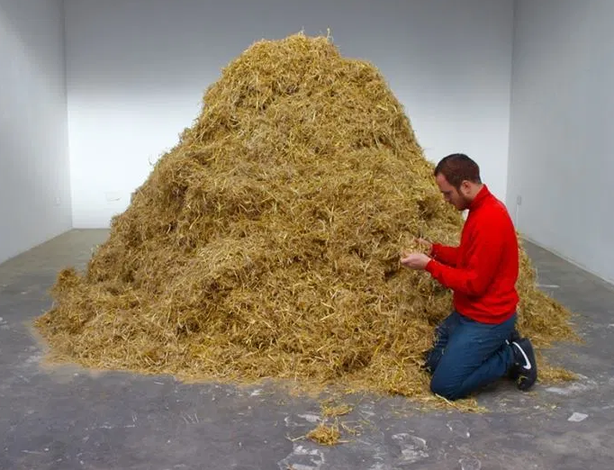
General RE Strategies (cont.)
Look for the signs
Magic numbers
Common algorithms (hashing, encryption, ...)
Systems calls and library functions
There are tools and plugins to help
Document, document, document
A lot of info is lost in compilation
Body of code is usually very large, and details are easy to forget
As you analyze the code:
Add names to functions and variables
Restore data structures and objects
Comment important code blocks
Rinse and repeat

Slide 36
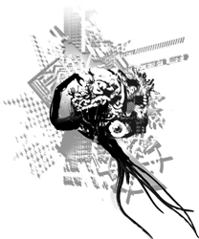
Resources
Lots of blogs, articles, writeups online
Google is your friend
Conferences
REcon (held in Montreal and Brussels) https://recon.cx/
Getting help online
Reverse Engineering Discord - https://discord.com/invite/weKN5wb (invite may expire)
https://www.reddit.com/r/ReverseEngineering/
https://reverseengineering.stackexchange.com/

Slide 37
Books
Eilam, E. "Reversing: Secrets of Reverse Engineering"
Yurichev, D. "Reverse Engineering for Beginners"
Sikorski, M. "Practical Malware Analysis: The Hands-On Guide to Dissecting Malicious Software"
Dang, B. "Practical Reverse Engineering: x86, x64, ARM, Windows Kernel, Reversing Tools, and Obfuscation"
Eagle, C. "The IDA Pro Book, 2nd Edition: The Unofficial Guide to the World's Most Popular Disassembler"

Slide 38
Wrap-up
A lot of software and hardware around us are "black boxes"
RE allows you to look inside and understand how they work
You can help make them more secure, build compatible solutions, and modify them in new ways based on RE knowledge
Plenty of tools are available to help reverse any product out there
As you learn more about it, I'm sure you will enjoy RE as a fun and intellectually-rewarding activity!

Slide 39
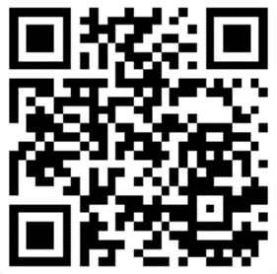
Q&A
@0xd13a on Discord/Twitter https://www.linkedin.com/in/beryozad
Slides can be found at https://github.com/0xd13a/presentations
Thank you!

